Slide 1
PROBABILITY THEORY
Om Kshatriya
Vanshaj Nathani

Slide 2
THE MONTY HALL PROBLEM

Slide 3
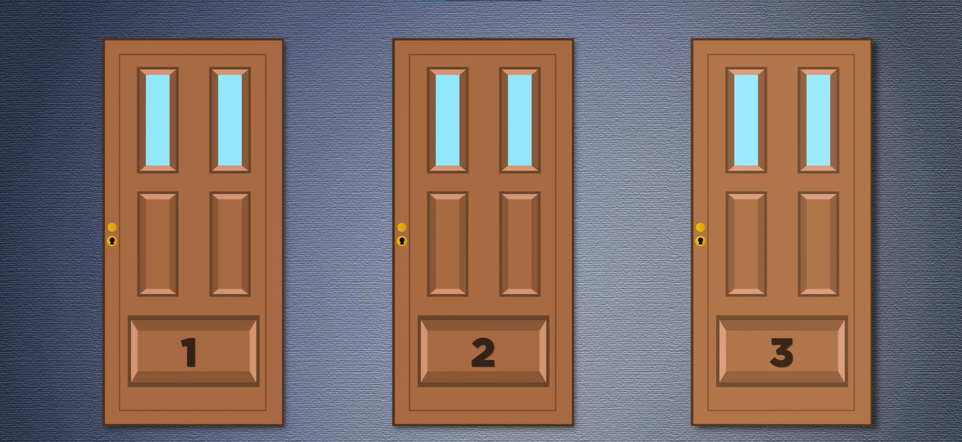
1 of the door has prize, and the other 2 have goats behind them

Slide 4
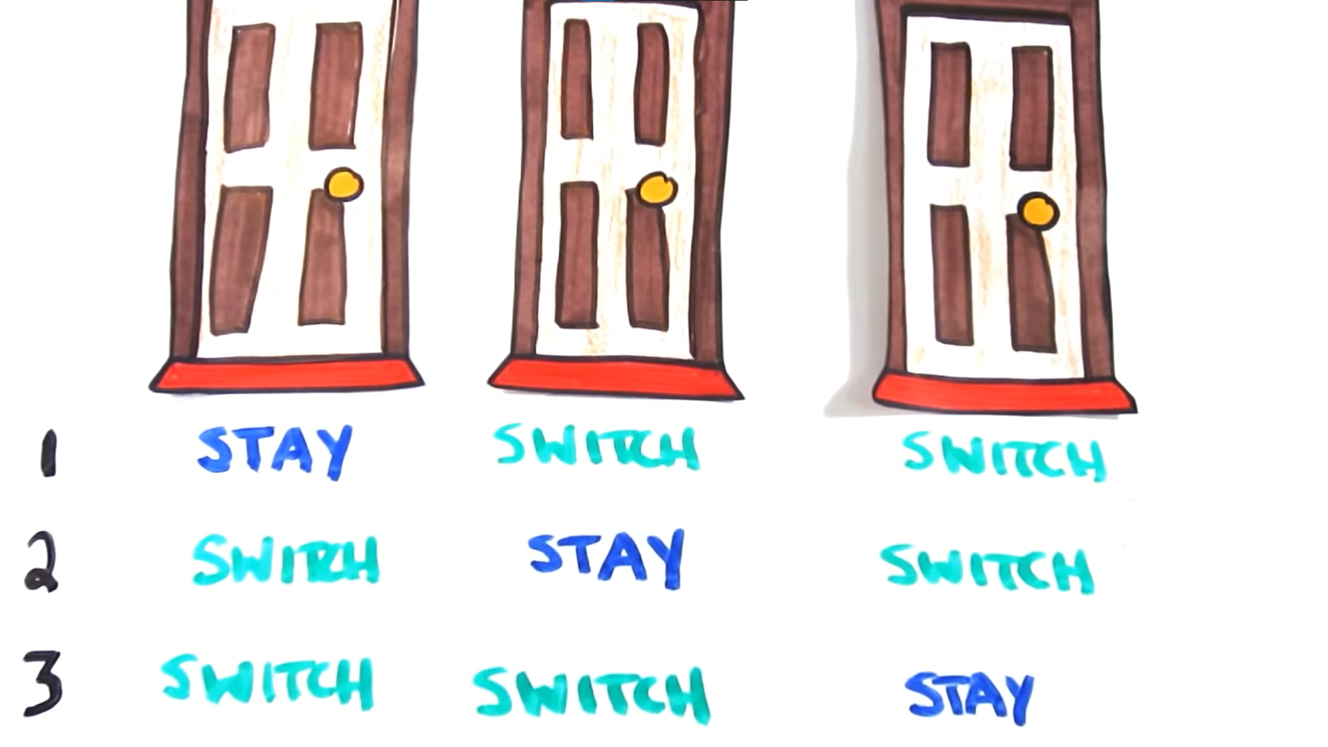
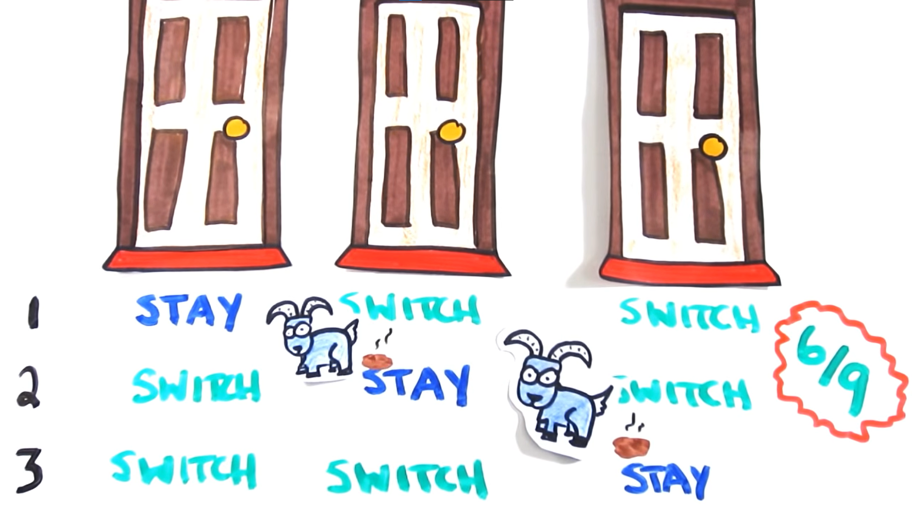
To Switch or Not To Switch is the question
The answer: SWITCH
Photo by Pixabay

Slide 5
Building a 2-class Naive Bayes Classifier with 1-Dimensional Input
This presentation covers the steps for building a 2-class Naive Bayes classifier with 1-dimensional input, a machine learning model that can classify input data into two classes based on a single feature or input variable.

Slide 6
What is a 2-class Naive Bayes Classifier?
- A machine learning model that uses Bayes' theorem to calculate the probability of an input belonging to a particular class.
- In a 2-class classification problem, two classes are considered, and the class with the higher probability is predicted.

Slide 7
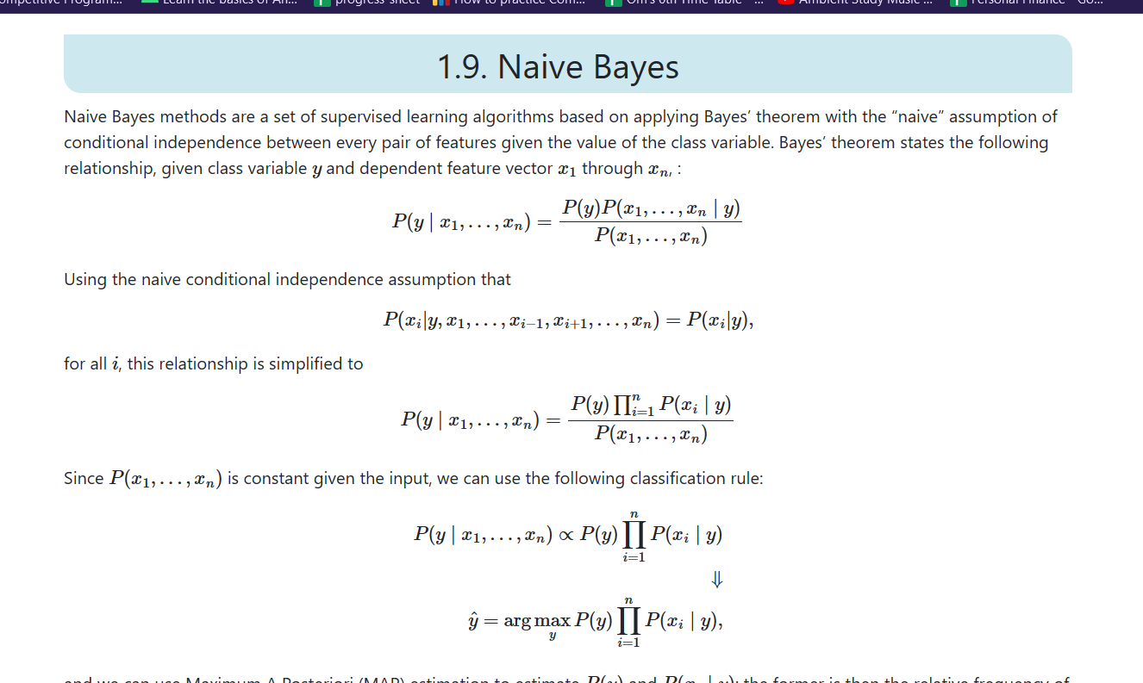

Slide 8

1-Dimensional Input
- Data is split into a training and testing set.
- Prior probabilities of each class are calculated.
- Class-conditional probabilities are estimated using a probability density function.
- Posterior probabilities are calculated using Bayes' theorem.
- Input is classified as the class with the higher posterior probability.
- Model performance is evaluated using metrics such as accuracy, precision, recall, and F1 score.
Photo by Pixabay

Slide 9

Advantages of Naive Bayes
- Relatively simple and computationally efficient.
- Can be trained on small datasets.
Photo by Pixabay

Slide 10

Limitations of Naive Bayes
- Assumes input features are independent of each other, which may not be true in all cases.
Photo by Pixabay

Slide 11
BIRTHDAY PARADOX

Slide 12


Slide 13
What is the minimum number of people you need to have for the probability of a birthday clash to be at least 50%?
Photo by Pixabay

Slide 14
The answer: 23
Photo by Pixabay

Slide 15
PRISONER RIDDLE

Slide 16
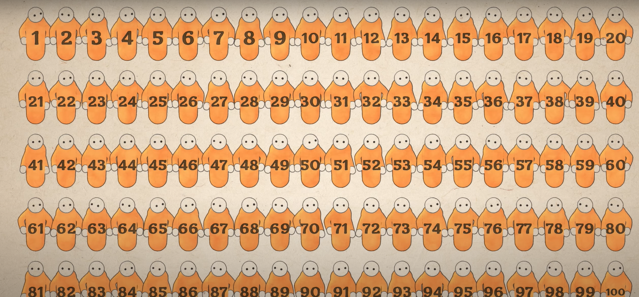
Photo by Pixabay

Slide 17

Photo by Pixabay

Slide 18

Random Arrangement of Slips
Photo by Pixabay

Slide 19
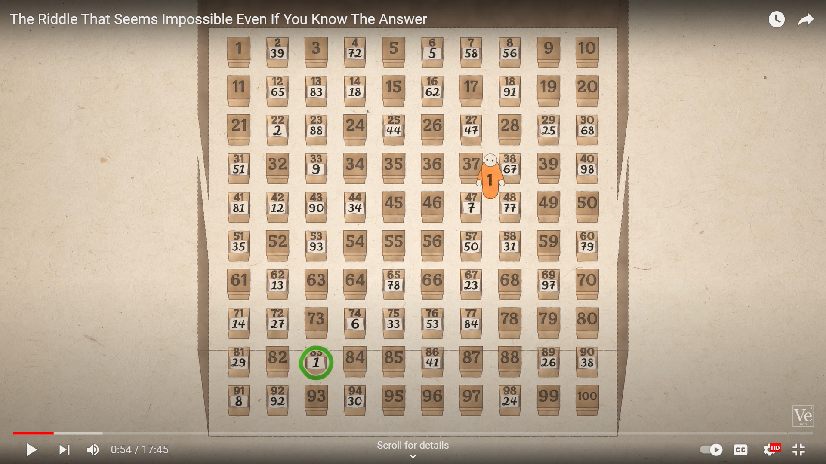
All are saved if all of them find their number,
All are executed if one one of them doesn’t find his number
Photo by Pixabay

Slide 20
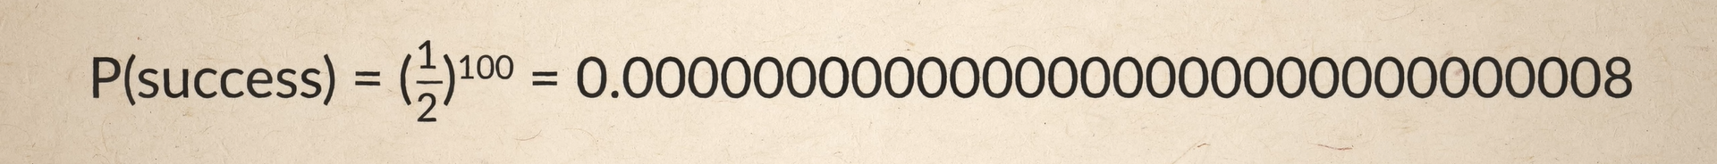
Lets Calculate the Probability of Winning with Random Choice

Slide 21
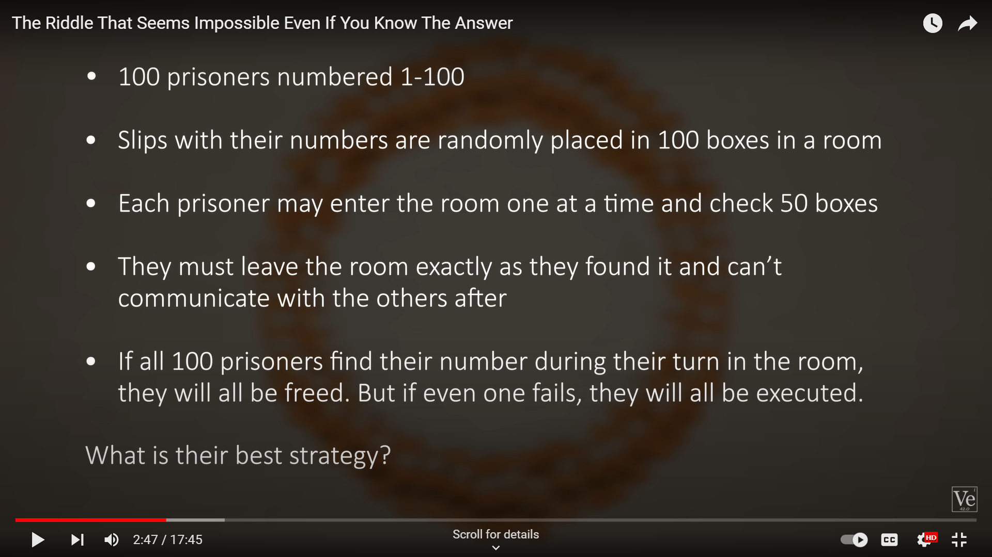
Photo by Pixabay

Slide 22
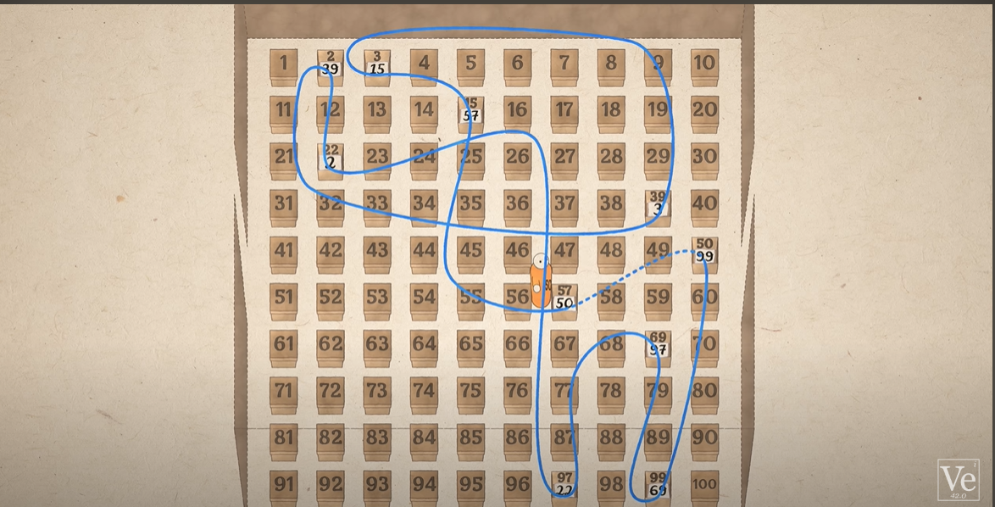
First thing to notice: Every number makes a loop
Photo by Pixabay

Slide 23

Photo by Pixabay

Slide 24
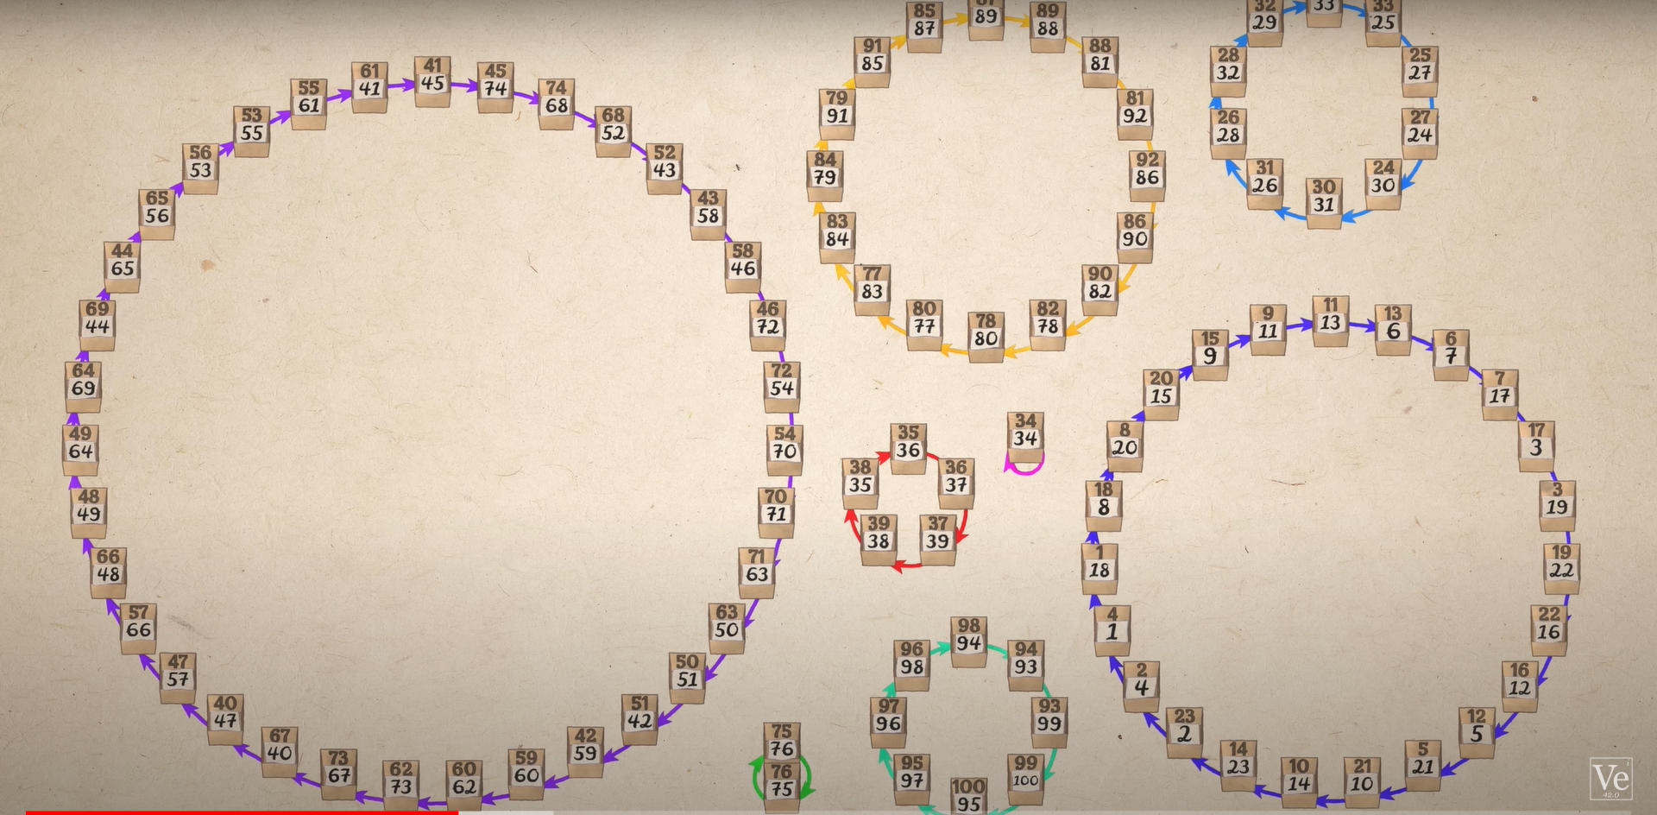
What is a 2-class Naive Bayes Classifier?
- A machine learning model that uses Bayes' theorem to calculate the probability of an input belonging to a particular class.
- In a 2-class classification problem, two classes are considered, and the class with the higher probability is predicted.

Slide 25
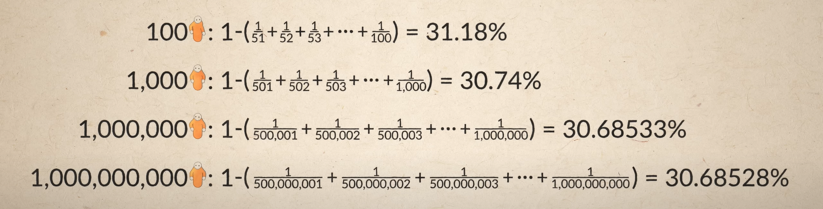
Calculating the General result

Slide 26
Thank you. Please feel free to ask any questions. 😄
The python files of the simulation can be found here.
@https://github.com/OKomk/FacultyDevelopmentProgram2023

